Slide 1
OCR Character Recognition
Presented by -
Anmaya Agarwal (N002)
Yash Katariya (N024)
Saketh Mantha (N028)
Keval Savla (N044)
Jay Gala (N066)

Slide 2

Introduction
In the current world, there is a growing demand for software systems to recognize characters written on a piece of paper in computer systems.
Optical character recognition usually abbreviated to OCR, involves a computer system designed to translate images of typewritten text (usually captured by a scanner) into machine editable text.
The scope of our project is to provide an efficient and enhanced software tool for reading and recognizing the characters in research, academic, governmental and business journals.
Notes:
After 1st Point -
These days there is a huge demand in “storing the information available in these paper documents such as newspapers and journals in to a computer storage disk and then later reusing this information by searching process”. One simple way to store information in these paper documents in the computer system is to first scan the documents and then store them as IMAGES. But to use this information is very difficult since we have to read the individual contents and search the contents from these documents line-by-line and word-by-word which is really inefficient.

Slide 3
How does it work ?
Step 1: Image Pre-Processing in OCR - OCR software often pre-processes images to improve the chances of successful recognition. The aim of image pre-processing is an improvement of the actual image data. In this way, unwanted distortions are suppressed and specific image features are enhanced.
Step 2: Character Recognition in OCR – Now that our image has been processed it is now sent to the pytesseract library where the library converts the image to machine readable text.

Slide 4
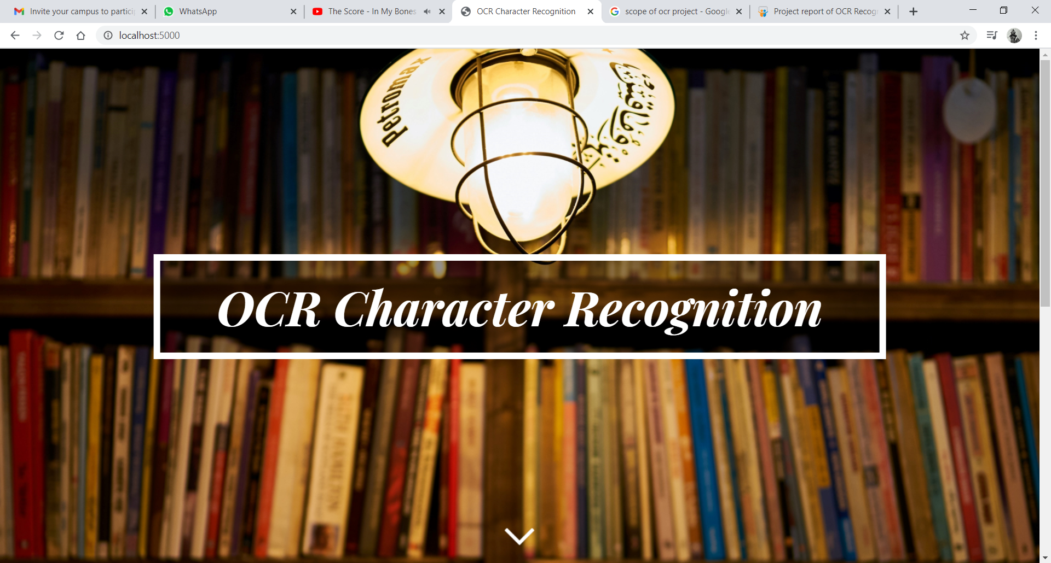
Layout (UI Design)

Slide 5
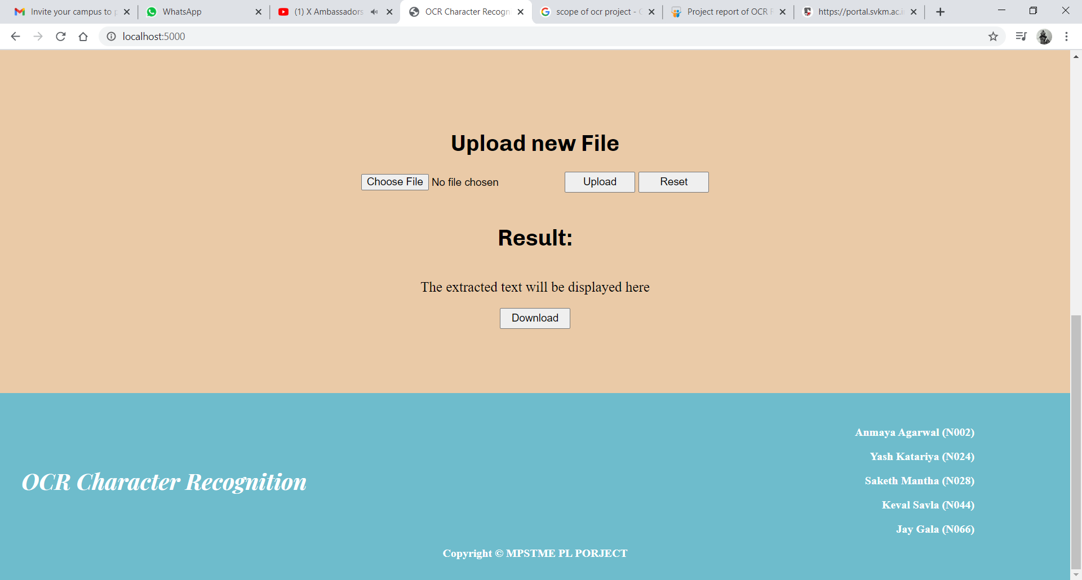
Layout (UI Design)

Slide 6
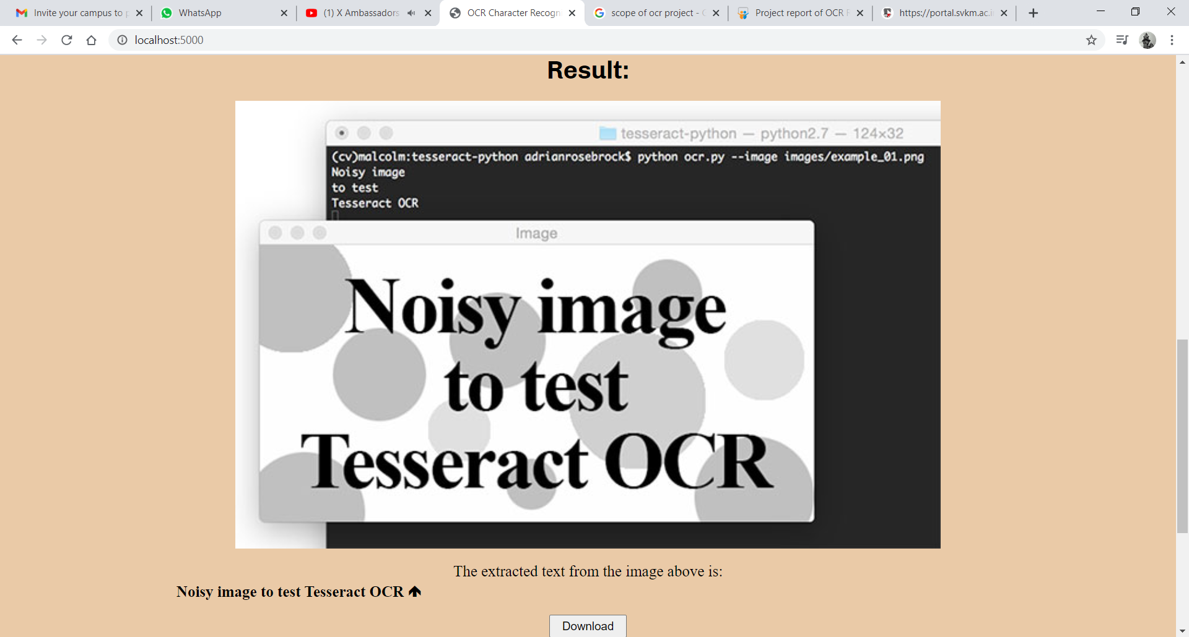
Layout (UI Design)

Slide 7
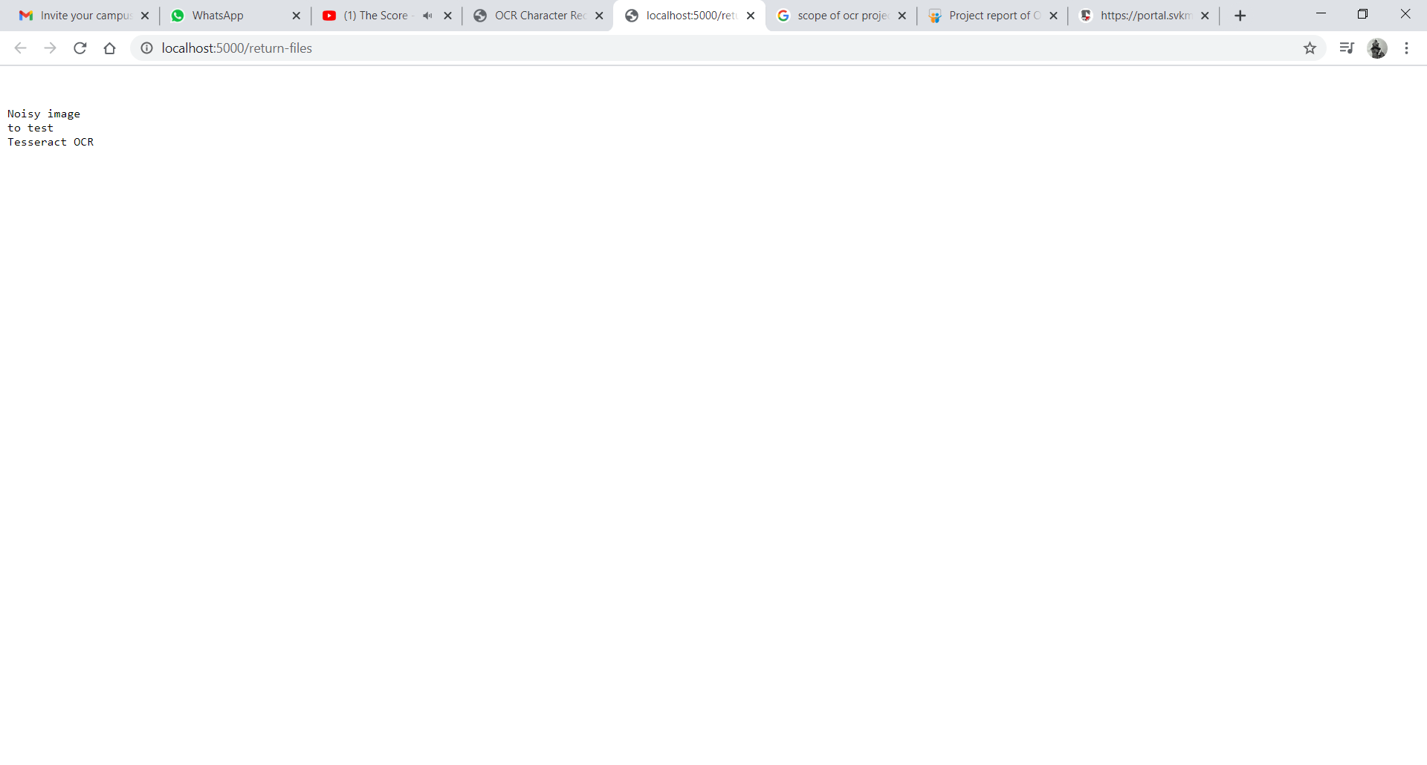
Layout (UI Design)

Slide 8
Software Used
Flask - Flask is a popular Python web framework. It is a third-party Python library used for developing web applications. Flask is based on the Werkzeg Web Server Gateway Interface (WSGI) toolkit and the Jinja2 template engine.
HTML & CSS - The HyperText Markup Language, or HTML is the standard markup language for documents designed to be displayed in a web browser. It can be assisted by technologies such as Cascading Style Sheets which is a style sheet language used for describing the presentation of a document written in a markup language such as HTML. CSS is a cornerstone technology of the World Wide Web, alongside HTML.

Slide 9
Software Used
Pillow - Python Imaging Library is a free and open-source additional library for the Python programming language that adds support for opening, manipulating, and saving many different image file formats.
Numpy - NumPy stands for Numerical Python. It is an open source project and you can use it freely. NumPy is a Python library used for working with arrays. By reading the image as a NumPy array ,various image processing can be performed using NumPy functions.

Slide 10
Conclusion & Future Scope
Nowadays, it is really important to keep your documents handy and digitizing these documents can be very difficult. So that’s why we came up with this idea for our project.
Given enough entrepreneurial designers and sufficient research and development dollars, OCR can become an even more powerful tool.
Some of its future applications can include – Converting handwriting in real-time to control a computer, Make electronic images of printed documents searchable, Extracting business card information into a contact list, etc.
Notes:
Before 2nd point –
Although OCR recognition is already a very powerful tool

Slide 11
Thank You!

